Slide 1
Geometry
In this lesson we revisit all the main rules and terms of line and triangle geometry.
We then try and calculate some angles.
In the first part, give yourself 1 point for every rule, term or measurement that you get correct.

Slide 2
Types of Angle
Below are 4 types of angles.
Name each type.
right angled
acute
obtuse
reflex

Slide 3
Rule 1
180°
Angles on a straight line add up to ……
75°
60°
45°
180° - (75° + 60°) = 45°

Slide 4
Rule 2
360°
Angles at a point add up to ………
75°
50°
105°
55°
75°
360° - (75° + 50° + 55° + 75°) = 105°

Slide 5
Rule 3
equal
Vertically opposite angles are …………
78°
78°

Slide 6
Rule 4
180°
Angles in a triangle sum to ………
52°
80°
48°
180° - (80° + 48°) = 52°

Slide 7
Rule 5
equal
Angles in an equilateral triangle are ………
Each angle size is ……
60°
60°
60°
60°

Slide 8
Rule 6
Base angles of an isosceles triangles are
………
equal
42°
180° - 42 = 138°
138° ÷ 2 = 69°
69°
69°

Slide 9
Rule 7
The exterior angle of a triangle is equal to
……………………………………………………………
the sum of the interior opposite angles
65°
52° + 65° = 117°
52°
117°

Slide 10
Rule 9
Angles that add up to 90˚ are called:
Complementary
Complimentary
Choose the correct spelling.
XXXXXXXXXXXX
25°
65°

Slide 11
Rule 10
Angles that add up to 180˚ are called
…………………………
supplementary
158°
22°

Slide 12
Rule 11 (for parallel lines)
equal
Alternate angles are …………… (alternate angles form a Z shape)
88°
88°

Slide 13
Rule 12 (for parallel lines)
corresponding
………………………… angles are equal (they form an F shape)
73°
73°

Slide 14
Rule 13 (for parallel lines)
supplementary
Co-interior angles are ……………………. (they form a U shape)
106°
74°

Slide 15
Name These Polygons
A three sided polygon is called a
…………………………
Name 4 types of triangle
…………………………
…………………………
…………………………
…………………………
triangle
Right angled
Scalene
Equilateral
Isosceles

Slide 16
Name These Polygons
A 4 sided polygon is called a
…………………………
Name 4 types of quadrilateral
…………………………
…………………………
…………………………
…………………………
quadrilateral
square
rectangle
trapezium
parallelogram

Slide 17
Name These Polygons
pentagon
5 sides ………………
6 sides ………………
7 sides ………………
8 sides ………………
9 sides ………………
10 sides ………………
11 sides ………………
12 sides ………………
hexagon
heptagon
octagon
nonagon
decagon
hendecagon
dodecagon

Slide 18
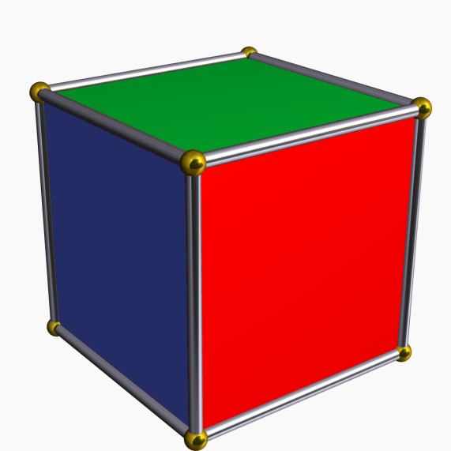
Do you know this?
What is the difference between a polygon and a polyhedron?
A polygon is a flat figure, like a square.
A polyhedron is a 3D figure, like a cube.

Slide 19
Rule 14
The sum of the exterior angles of a polygon is …………
360°
72°
90°
72°
90°
72°
72°
90°
72°
90°

Slide 20
Rule 15
The sum of the interior angles of a polygon is (n – 2) × 180˚
What does the n stand for?
65°
n = the number of sides
for a triangle n = 3
(3 – 2) × 180˚ = 180˚
35°
80°

Slide 21
Geometry Review
What did you score?
Did you get over 50?
Only 49 points were available!

Slide 22
Angle Geometry
Find the missing angles.
2x + 58 + 24 = 180°
2x = 98°
x = 49°
58°
x
x
24°

Slide 23
Angle Geometry
Find the missing angles.
21 + 90 + x = 180°
x = 69°
y = 111°
x
y
x
21°

Slide 24
Angle Geometry
Find the missing angles.
y = 82°
y
x
116°
34°
x = 64°

Slide 25
Angle Geometry
Find the missing angles.
x = 72°
x
y
z
71°
37°
z = 109°
y = 143°

Slide 26
Angle Geometry
Find the missing angles.
x = 60°
x
z
y
60°
z = 120°
y = 60°

Slide 27
Angle Geometry
Find the missing angles.
y
y = 77°
x
z
z = 77°
26°
x = 154°

Slide 28
Angle Geometry
w = 40°
Find the missing angles.
x = 70°
x
y = 40°
30°
z = 140°
140°
z
w
70°
y

Slide 29
Angle Geometry
Find the missing angles.
w =124°
w
x = 98°
84°
x
u = 110°
124°
26°
w =128°
u
40°
v
z
v = 26°
30°
v

Slide 30
Angle Geometry
Find the missing angles.
x
z
w
32°
y
w
z
y = 32°
z = 148°
w = 58°
x = 122°
x

Slide 31
Angle Geometry
Do you remember the formula for the sum of the interior angles of a polygon?
(n – 2) × 180˚
Therefore what will be the sum of the interior angles of a quadrilateral?
360˚

Slide 32
Angle Geometry
Here is a regular hexagon.
Write the size of the red angles.
60°
360° ÷ 6 = 60°
60°

Slide 33
Angle Geometry
Write the size of the interior angles.
(n - 2)  180
= 4  180˚
= 720˚
= 720˚ ÷ 6
= 120˚
Regular hexagon
120°
120°
120°
120°
120°
60°
120°
Or from previous example 60 + 120 = 180

Slide 34
Angle Geometry
Find the missing angles.
y = 132°
y
132°
x
x = 48°

Slide 35
Angle Geometry
Find the missing angles.
73°
77°
x
105°
75°
x = 105°
y = 75°
y

Slide 36
Angle Geometry
Find the missing angles.
2x + 4x + x + 5x = 12x
12x = 360°
x = 30°
4x
120°
2x
x
60°
30°
150°
5x

Slide 37
Angle Geometry
Find the missing angles.
x = 156°
v = 24°
24°
x
v
z
w
v = 24°
y = 156°
y
z = 156°

Slide 38
Angle Geometry
Find the missing angles.
v
v = 136°
44°
x = 44°
w
x
w = 46°
y
z
z = 46°
y = 44°

Slide 39
Angle Geometry
Find the missing angles.
w = 125°
v = 108°
w
v
55°
72°
x
x = 108°
y
z = 55°
z
y = 125°

Slide 40
Angle Geometry
Find the missing angles.
27°
z
z = 153°
x
y
x = 27°
y = 27°
Alternate (Z) angles are equal.

Slide 41
Angle Geometry
Find the missing angles.
z
z = 153°
y
y = 27°
Co-interior (U) angles are supplementary.

Slide 42
An “Excellence” Question
Prove that angle A is 2  angle B.
Can you add a radius to make an isosceles triangle?
B
A

Slide 43
An “Excellence Question”
Draw in an extra radius
Radius 1
An isosceles triangle
c
c
Radius 2

Slide 44
An “Excellence Question”
Exterior angles = sum of interior opposite angles (Rule 7)
c
c
2c

Slide 45
An “Excellence Question”
Have you solved the question?
c
d
d
c
2c
2d

Slide 46
The NZ Centre of Mathematics
www.mathscentre.co.nz

